Slide 1
Recognition and classification of yield affecting paddy crop stresses using field images
Guide: Submitted By:
FOUSIA M SHAMSHUDEEN ASHLY ELIZABETH JOSHY(07)
SREELAKSHMI.S(29)

Slide 2
CONTENTS
INTRODUCTION
TECHNOLOGIES USED
DESIGN
RESULT

Slide 3
INTRODUCTION
Aims to design different convolutional neural network (CNN) framework for automatic recognition and classification of various paddy crop stresses using the field images.
The work has adopted CNN and pre-trained VGG-16 CNN model for the classification of stressed paddy crop images .

Slide 4
TECHNOLOGIES USED
OS: Windows 10
Back end: Python TensorFlow deep learning framework
Library: Keras
Classification: CNN, VGG-16(Virtual Geometry Group)
Features: Colour, Shape, Texture
Dataset : Rice-leaf(stresses: Bacterial blight, Fungal blast, Brownspot)

Slide 5
DESIGN
Dataset
Resizing images in dataset
Attribute Selection
Training Data
Splitting Dataset
Into Training and Validation
Test Data
Bacterial leaf blight
Brown spot
Apply Classification Algorithms
Classification Model
Predictions of Classifying three stresses
Leaf smut

Slide 6
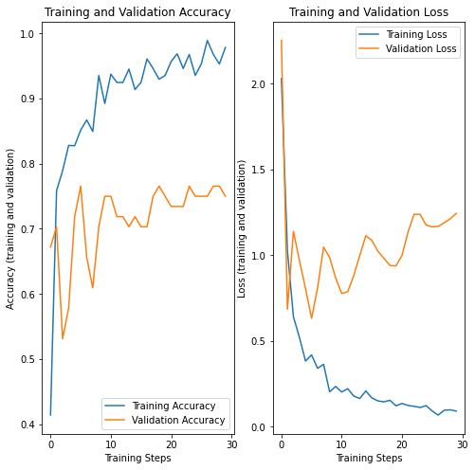

Slide 7
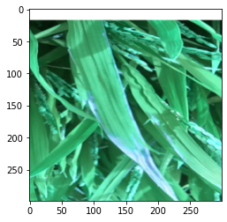
SOURCE: class: bacterial_leaf_blight,
file:bacterial_leaf_blight/blight_rotated_012.png
PREDICTED: class: Bacterial_leaf_blight, confidence: 0.493930
<Figure size 432x288 with 0 Axes>

Slide 8
THANK YOU

